Slide 1
HOTEL MANAGEMENT SYSTEM
PRESENTED BY:
NAVEENA RASHID(233697)
TAYYABA KHALID(233700)
ABEER FATIMA(233666)

Slide 2
TABLE OF CONTENTS
Introduction
Reception Room
Server Room
IT Department
Security Room
Conclusion

Slide 3
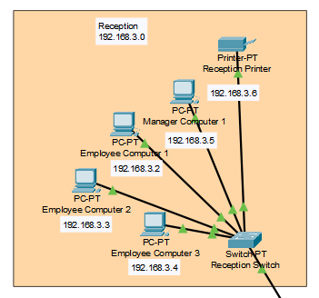
Reception Room: 1- Manages guest check-ins/outs, reservations, and billing through a front-desk computer system connected to the central server. 2- Includes a guest information database, allowing staff to quickly access booking details and preferences for personalized service.

Slide 4
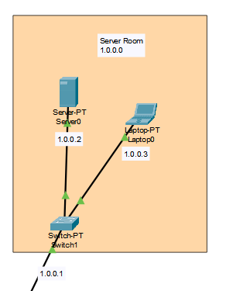
Server Room
1- Houses the central servers that store guest information, manage bookings, and run the property management software.
2- Provides centralized data storage with backups to ensure data security and availability in case of system failures.

Slide 5
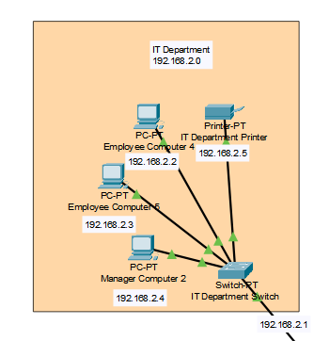
IT Department: 1- Maintains the hotel's network infrastructure, ensuring smooth connectivity between systems like Wi-Fi, servers, and guest devices. 2- Handles the integration of third-party applications like online booking platforms and payment gateways.

Slide 6
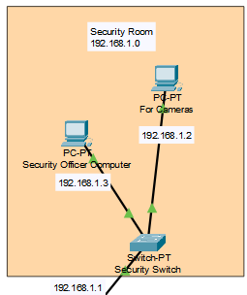
Security Room
1- Monitors cctv feeds, access control systems, and alarm systems connected to the network for safety.
2- Integrates with the fire alarm system and emergency protocols to provide real-time alerts and responses to incidents.

Slide 7
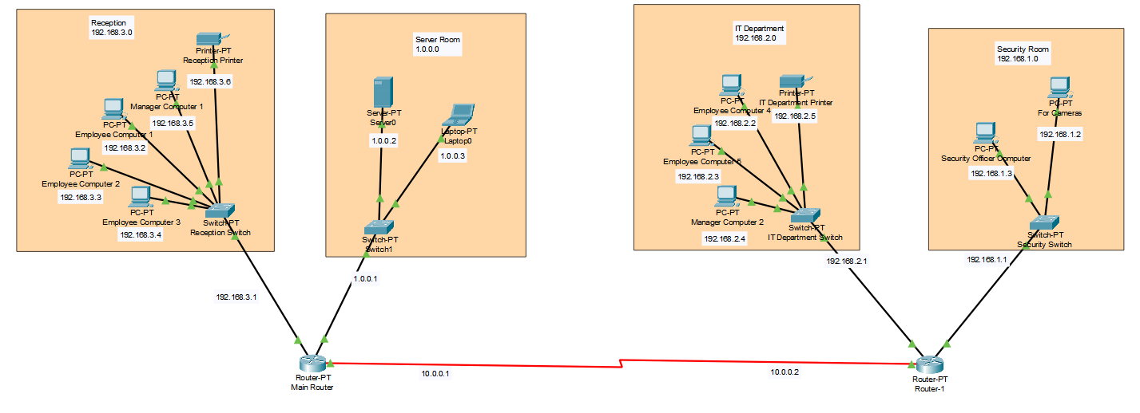
navigating q&a sessions
Know your material in advance
Anticipate common questions
Rehearse your responses
Maintaining composure during the Q&A session is essential for projecting confidence and authority. Consider the following tips for staying composed:
Stay calm
Actively listen
Pause and reflect
Maintain eye contact

Slide 8
Conclusion
All systems are interconnected through a secure network for efficient operation.

Slide 9
Thank you
If you have any questions please hesitate ☺

